Slide 1
Exercise - Learning Objectives
By the end of this exercise you will be able to:
Define an already existing thermal power plant taking in fuel to generate electricity
Run the model and check results on production by technology and capacity of each technology

Slide 2
Demand for future connections
Natural Gas
Electricity
Demand for electrified population
Natural Gas Production
Hydro run-of-river
Transmission & Distribution
Hydro Dam
Grid Expansion
Natural Gas Imports
Wind
Dist. Solar PV
New CCGT/GT
Dist. Solar PV with battery
Backstop 1
Backstop 2

Slide 3
Demand for future connections
Natural Gas
Electricity
Demand for electrified population
Natural Gas Production
Hydro run-of-river
Transmission & Distribution
Hydro Dam
Grid Expansion
Natural Gas Imports
Wind
Dist. Solar PV
New CCGT/GT
Dist. Solar PV with battery
Backstop 1
Backstop 2

Slide 4
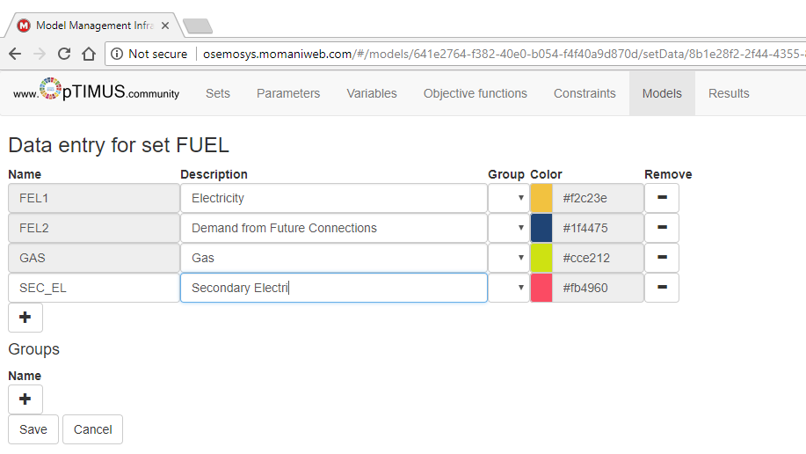
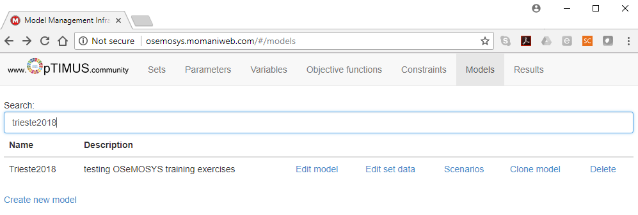
Building an electricity supply model
We start by creating a new FUEL called SEC_EL (for electricity that gets generated by power plants).
Snapshot required

Slide 5
Defining a thermal power plant
We continue to create a TECHNOLOGY called NGCC (i.e. natural gas combined cycle).
The following parameters are taken into account
InputActivityRatio: defines the rate of fuel consumed (i.e. Gas)
OutputActivityRatio: defines the rate of fuel provided (i.e. Electricity)
FixedCost: defines the fixed Operation & Maintenance cost ($M/GW or $/kW)
CapitalCost: defines the overnight investment cost of the plant ($M/GW or $/kW)
OperationalLife: defines the lifetime of the technology (in years)
ResidualCapacity: defines the existing capacity of the technology (in GW) and its expected decommissioning
CapacitytoActivityUnit: defines how much activity can occur by one unit of capacity in one year (in this case we are using GW for capacity and PJ for energy, thus 1 GW can provide 31.536 PJ annually)
Notes:
CapacityToActivityUnit: 1 GW (installed capacity) x 8760 h/yr = 8760 GWh → Activity per year = 31.536 PJ
CapacityToActivityUnit → TotMaxCapacity = GW * 8760h * 1yr * ConversionUnit (PJ/GW) → (it is a conversion factor) 8760 GWh = 31.536 PJ

Slide 6
Defining characteristics of the power plant
For the NGCC technology, let’s define the following.
InputActivityRatio: Choose the Gas fuel and insert the following for mode of operation 1.
Mode | 2014 | 2015 | 2016 | 2017 | 2018 | 2019 | 2020 | 2021 | 2022
1 | 1.992 | 1.992 | 1.992 | 1.992 | 1.992 | 1.992 | 1.992 | 1.992 | 1.992
 | 2023 | 2024 | 2025 | 2026 | 2027 | 2028 | 2029 | 2030 | 2031
1 | 1.992 | 1.992 | 1.992 | 1.992 | 1.992 | 1.992 | 1.992 | 1.992 | 1.992
 | 2032 | 2033 | 2034 | 2035 | 2036 | 2037 | 2038 | 2039 | 2040
1 | 1.992 | 1.992 | 1.992 | 1.992 | 1.992 | 1.992 | 1.992 | 1.992 | 1.992

Slide 7
Defining characteristics of the power plant
For the NGCC technology, let’s define the following.
OutputActivityRatio: Choose the SEC_EL fuel and insert the following for mode of operation 1.
Note that Input/OutputActivityRatio define efficiency: 50.2%
Mode | 2014 | 2015 | 2016 | 2017 | 2018 | 2019 | 2020 | 2021 | 2022
1 | 1 | 1 | 1 | 1 | 1 | 1 | 1 | 1 | 1
 | 2023 | 2024 | 2025 | 2026 | 2027 | 2028 | 2029 | 2030 | 2031
1 | 1 | 1 | 1 | 1 | 1 | 1 | 1 | 1 | 1
 | 2032 | 2033 | 2034 | 2035 | 2036 | 2037 | 2038 | 2039 | 2040
1 | 1 | 1 | 1 | 1 | 1 | 1 | 1 | 1 | 1

Slide 8
Defining characteristics of the power plant
For the NGCC technology, let’s define the following.
FixedCost: Insert the following.
 | 2014 | 2015 | 2016 | 2017 | 2018 | 2019 | 2020 | 2021 | 2022
NGCC | 44 | 44 | 44 | 44 | 44 | 44 | 44 | 44 | 44
 | 2023 | 2024 | 2025 | 2026 | 2027 | 2028 | 2029 | 2030 | 2031
NGCC | 44 | 44 | 44 | 44 | 44 | 44 | 44 | 44 | 44
 | 2032 | 2033 | 2034 | 2035 | 2036 | 2037 | 2038 | 2039 | 2040
NGCC | 44 | 44 | 44 | 44 | 44 | 44 | 44 | 44 | 44

Slide 9
Defining characteristics of the power plant
For the NGCC technology, let’s define the following.
ResidualCapacity: Insert the following.
 | 2014 | 2015 | 2016 | 2017 | 2018 | 2019 | 2020 | 2021 | 2022
NGCC | 0.55 | 0.55 | 0.55 | 0.55 | 0.55 | 0.55 | 0.55 | 0.55 | 0.55
 | 2023 | 2024 | 2025 | 2026 | 2027 | 2028 | 2029 | 2030 | 2031
NGCC | 0.55 | 0.55 | 0.55 | 0.55 | 0.55 | 0.55 | 0.55 | 0.55 | 0.55
 | 2032 | 2033 | 2034 | 2035 | 2036 | 2037 | 2038 | 2039 | 2040
NGCC | 0.55 | 0.55 | 0.55 | 0 | 0 | 0 | 0 | 0 | 0

Slide 10
Defining characteristics of the power plant
For the NGCC technology, let’s define the following.
CapitalCost: Insert the following values
The OperationalLife can be set to 30 years, while the CapacitytoActivityUnit can be set to 31.536.
 | 2014 | 2015 | 2016 | 2017 | 2018 | 2019 | 2020 | 2021 | 2022
NGCC | 1100 | 1100 | 1100 | 1100 | 1100 | 1100 | 1100 | 1100 | 1100
 | 2023 | 2024 | 2025 | 2026 | 2027 | 2028 | 2029 | 2030 | 2031
NGCC | 1100 | 1100 | 1100 | 1100 | 1100 | 1100 | 1100 | 1100 | 1100
 | 2032 | 2033 | 2034 | 2035 | 2036 | 2037 | 2038 | 2039 | 2040
NGCC | 1100 | 1100 | 1100 | 1100 | 1100 | 1100 | 1100 | 1100 | 1100

